Slide 1
Object Detection: Learning the Anchor Boxes
Jaehoon Chung, Dahye Jeong

Slide 2
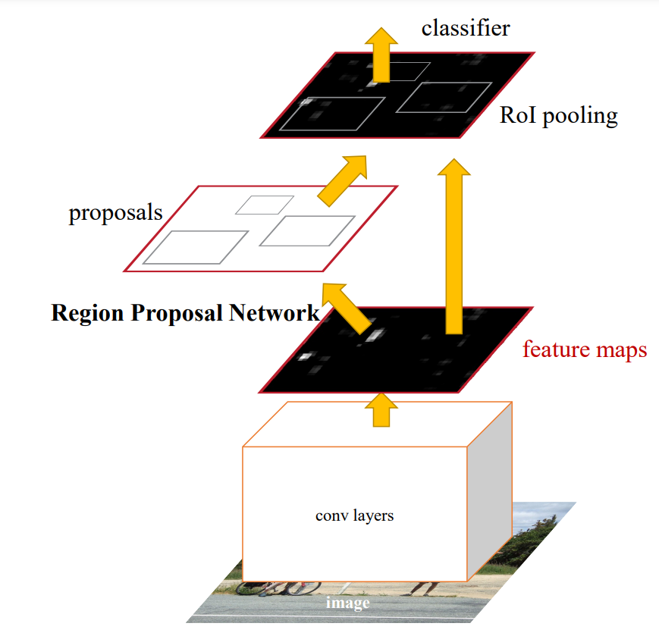
Problem Motivation
Faster R-CNN : Fast R-CNN + Region Proposal Network
Region Proposal Network classifies and regresses bounding boxes with reference to anchor boxes of multiple scales and aspect ratios (3 scales and 3 aspect ratios, yielding 9 anchors)
Limitations :
- Struggles to detect and localize small-size objects
- Not very good at dealing with objects with extreme scales or shapes

Slide 3
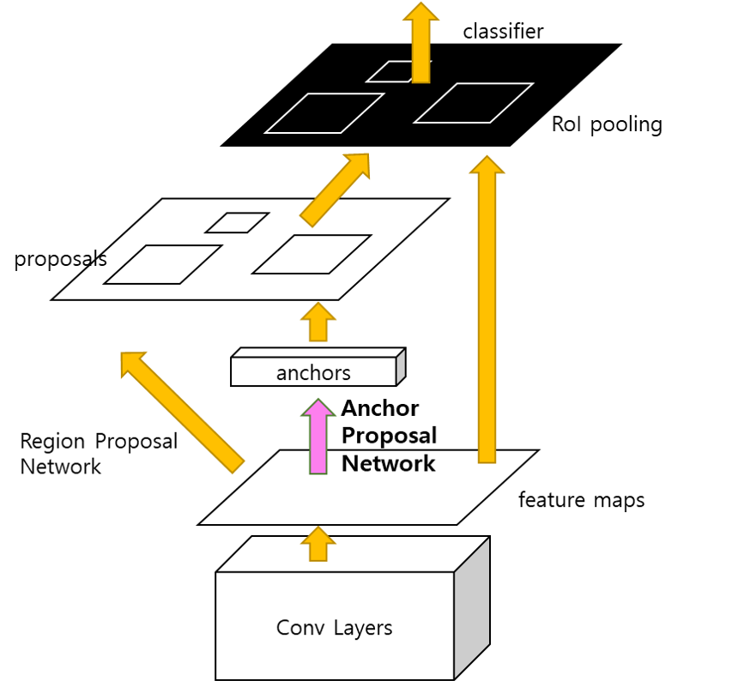
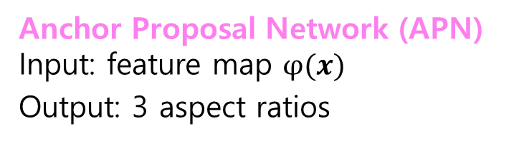
Our Approach
Training the shape of anchors
Anchor Proposal Network (APN) Input: feature map $φ(x)$
Output: 3 aspect ratios

Slide 4
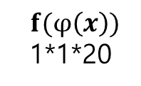
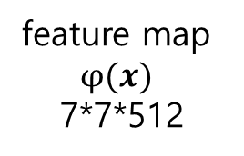
Anchor Proposal Network
feature map
$φ(x)$
7*7*512
$f(φ\left(x\right))$
1*1*20
25088
2048
20
2 fully-connected layers convert the feature map to 20-d vector

Slide 5
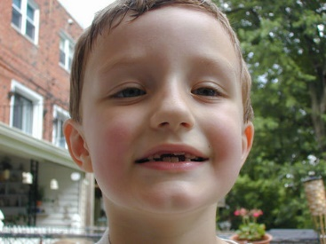
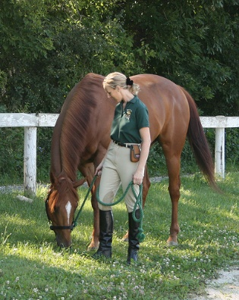
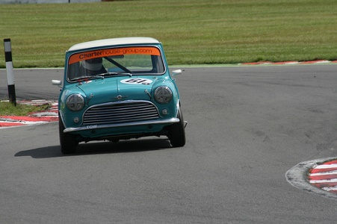
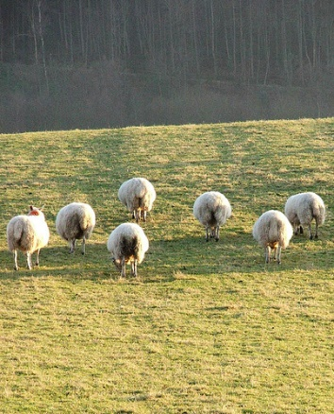

Candidate Aspect Ratios
VOC 2012
dataset
k-means clustering
on the ground truth
Bounding box ratios
k = the number of classes (VOC 2012) = 20
Candidate Aspect Ratios (20-d)
[0.327, 0.520, 0.687, 0.845, 1.017, 1.201, 1.380, 1.561, 1.750, 1.972,
2.242, 2.539, 2.845, 3.175, 3.562, 4.023, 4.814, 6.002, 7.889, 10.453]

Slide 6


Ground Truth & Loss
Distance Between Ratios:
$$d(r_{1},r_{2})=\frac{max⁡({r_{1},r}_{2})}{min⁡({r_{1},r}_{2})}$$
GT vector:
$GT\left(i\right)= \max_{r_{gt} ∈ R_{gt}}\frac{1}{d(r_{i},r_{gt})}, 1≤ i$ $≤$ 20
Example:
Candidates
0.3 | 0.5 | 0.7 | … | 10.5
0.5
GT Vector
0.66
0.93 | 1 | 0.94 | … | 0.06
0.28

Slide 7
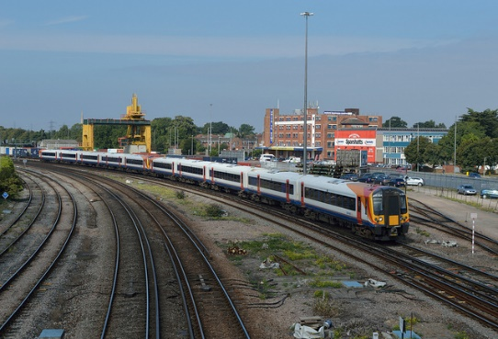
Training APNs
img
classifier
RoI pooling
VGG-16
GT
proposals
FC 2048
anchors
Region Proposal Network
FC 20
Anchor Proposal Network
feature maps
Select Top3
MSE Loss
Conv Layers
3 Anchors

Slide 8
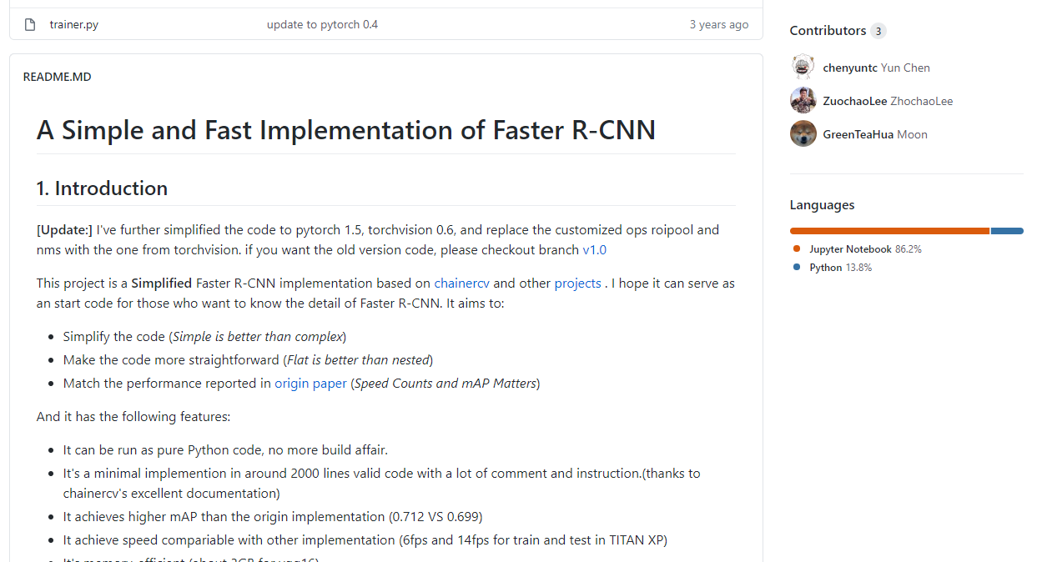
Results
Submission to PASCAL VOC2012 challenge
- Compared with a simple implementation of faster R-CNN
(https://github.com/chenyuntc/simple-faster-rcnn-pytorch)

Slide 9
Conclusion
Higher performance than the original Faster R-CNN
Room for Improvement:
1) APN only predicts aspect ratios -> make it predict scales also
2) APN chooses top 3 -> make it dynamically choose # of anchors

Slide 10
Thank You

